Slide 1
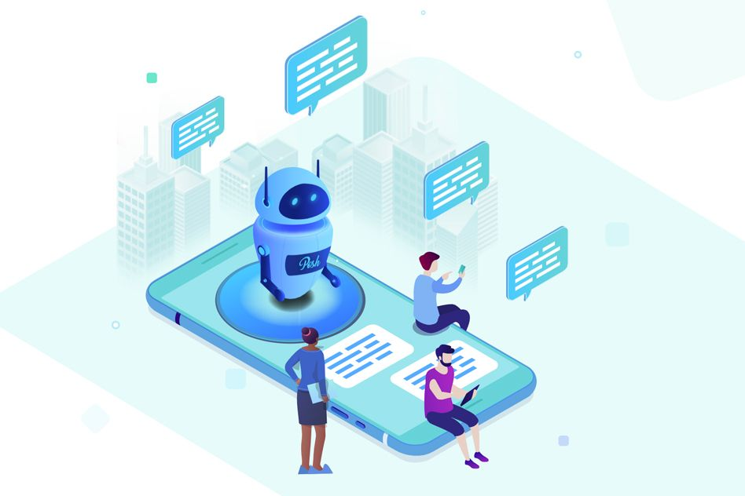
NEXTURN
ENGINEER YOUR AI ON CLOUD
TOPIC :
WEB BASED INTERACTIVE CHATBOT
FOR NEXTURN
1. USING NLP
2. USING LLM
PRESENTED BY :
A. RATNAKUMAR
SEENI ARIVAZHAKAN
M. SUNDARAM
MITTA VAMSI
,

Slide 2
SOLUTION OVERVIEW
The web-based chatbot, powered by RNN-based Deep Learning with PyTorch models targeting small scale or individual organizations and LLM based used widely, serves as an effective tool for providing immediate assistance to users.
It interacts with users through text or voice on corporate websites, aiming to address frequently asked questions and offer information promptly.

Slide 3
ARCHITECTURE DESIGN - NLP
Chatbot platform
Resides on the System
Question
User
Language
Parsing
Bot Engine
Knowledge
base
Answer

Slide 4
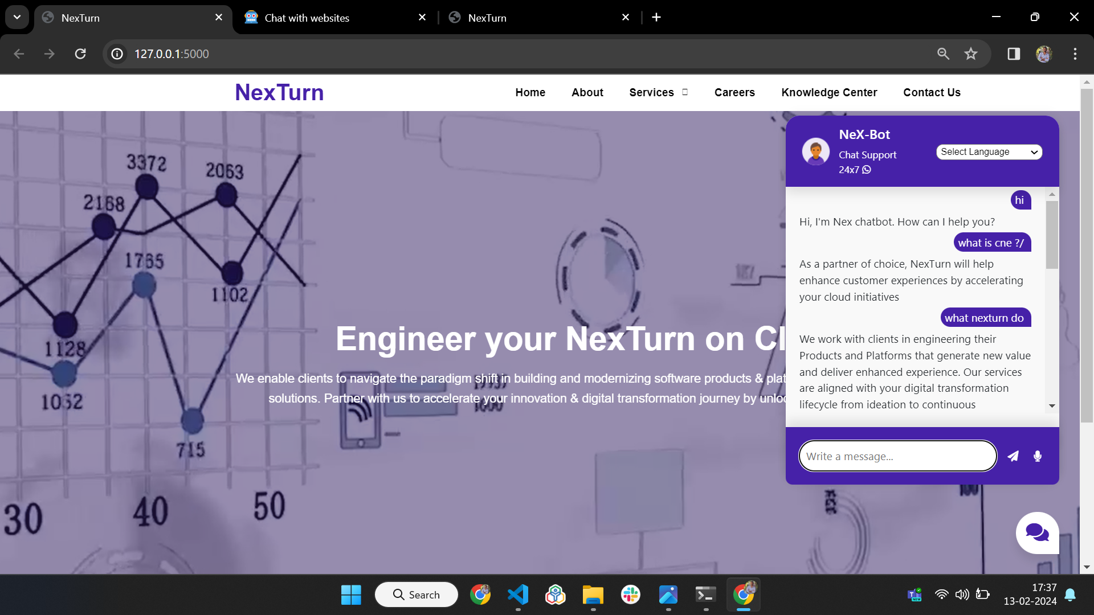
OUTPUT - NLP

Slide 5
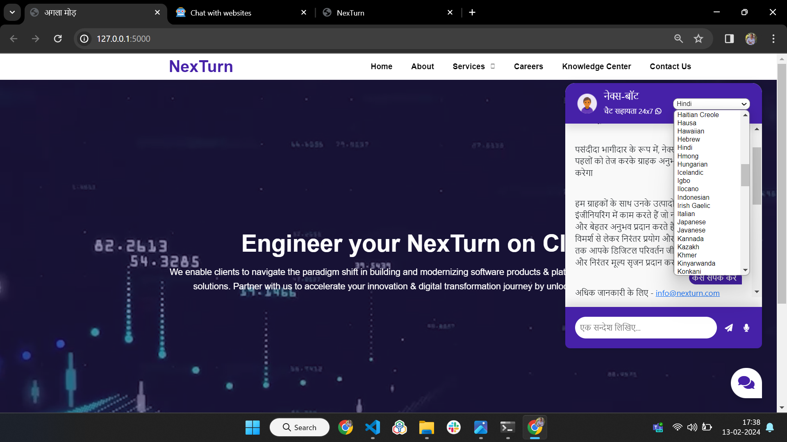
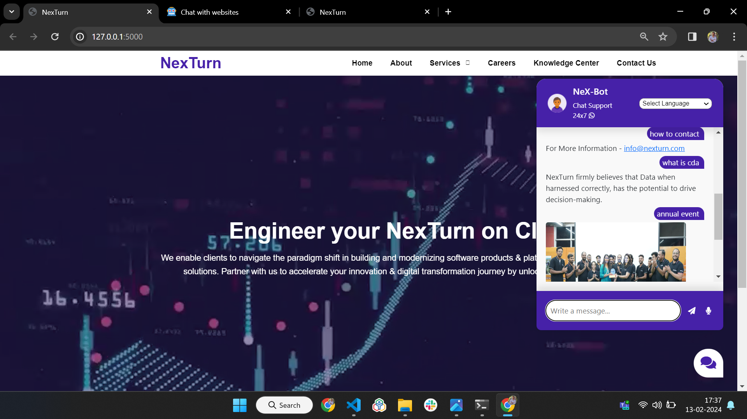
OUTPUT - NLP
** Here, We provided Multi Media Support to engage Users
** Here, We provided Translation and Voice Input System
for User Convenience

Slide 6
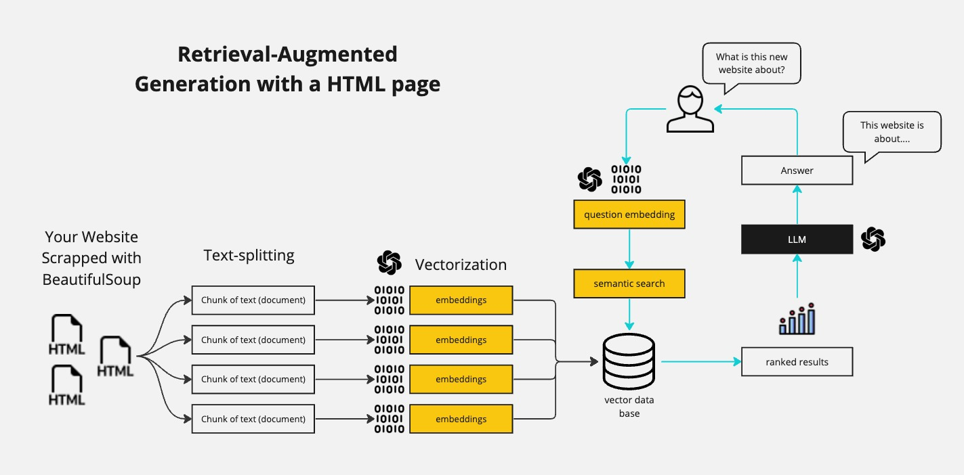
ARCHITECTURE DESIGN - LLM

Slide 7
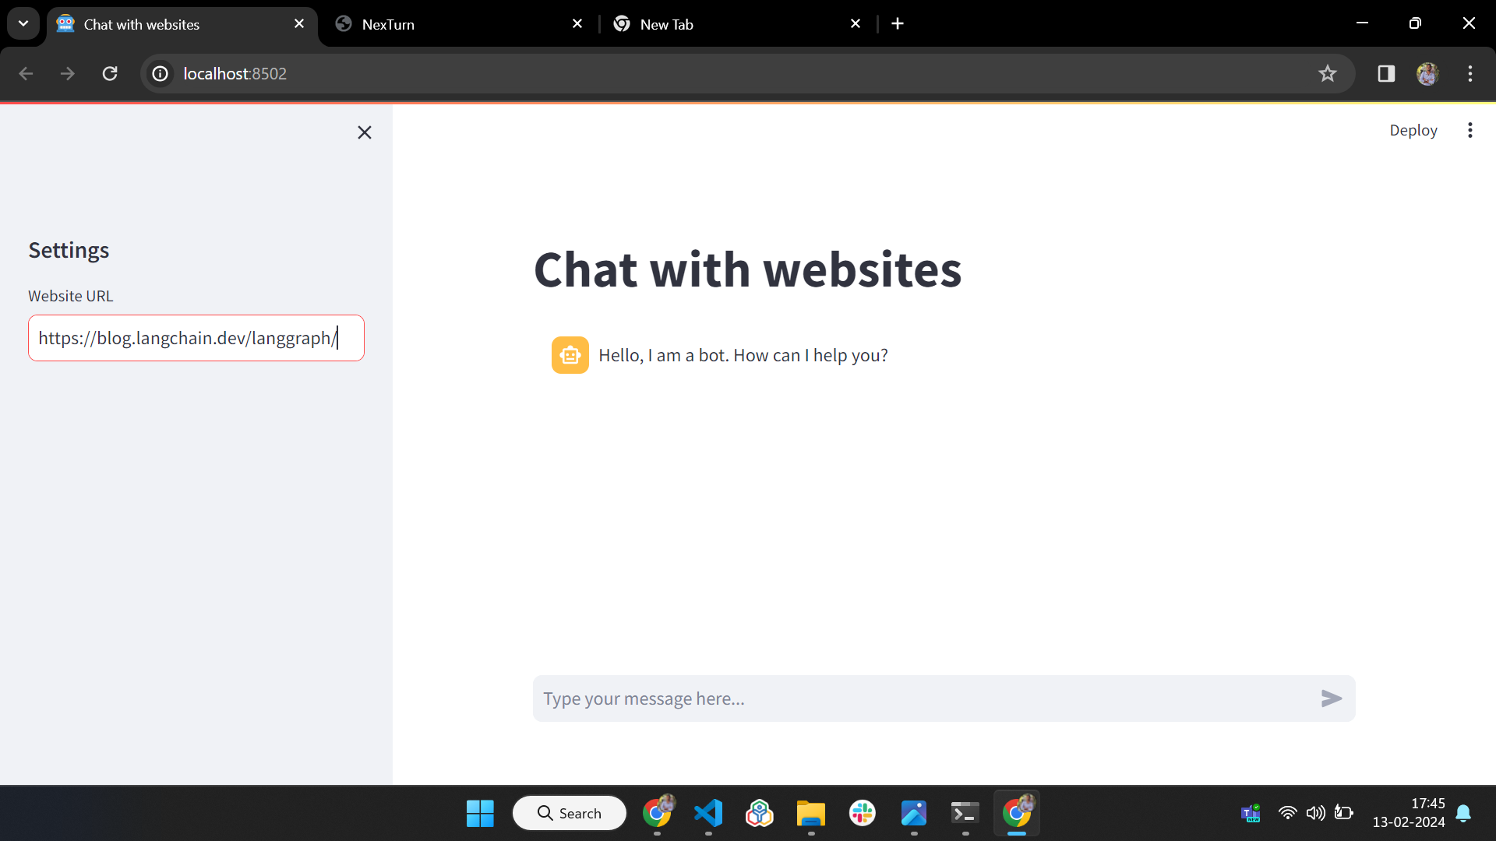
OUTPUT - using LLM (by training given Webite URL)

Slide 8
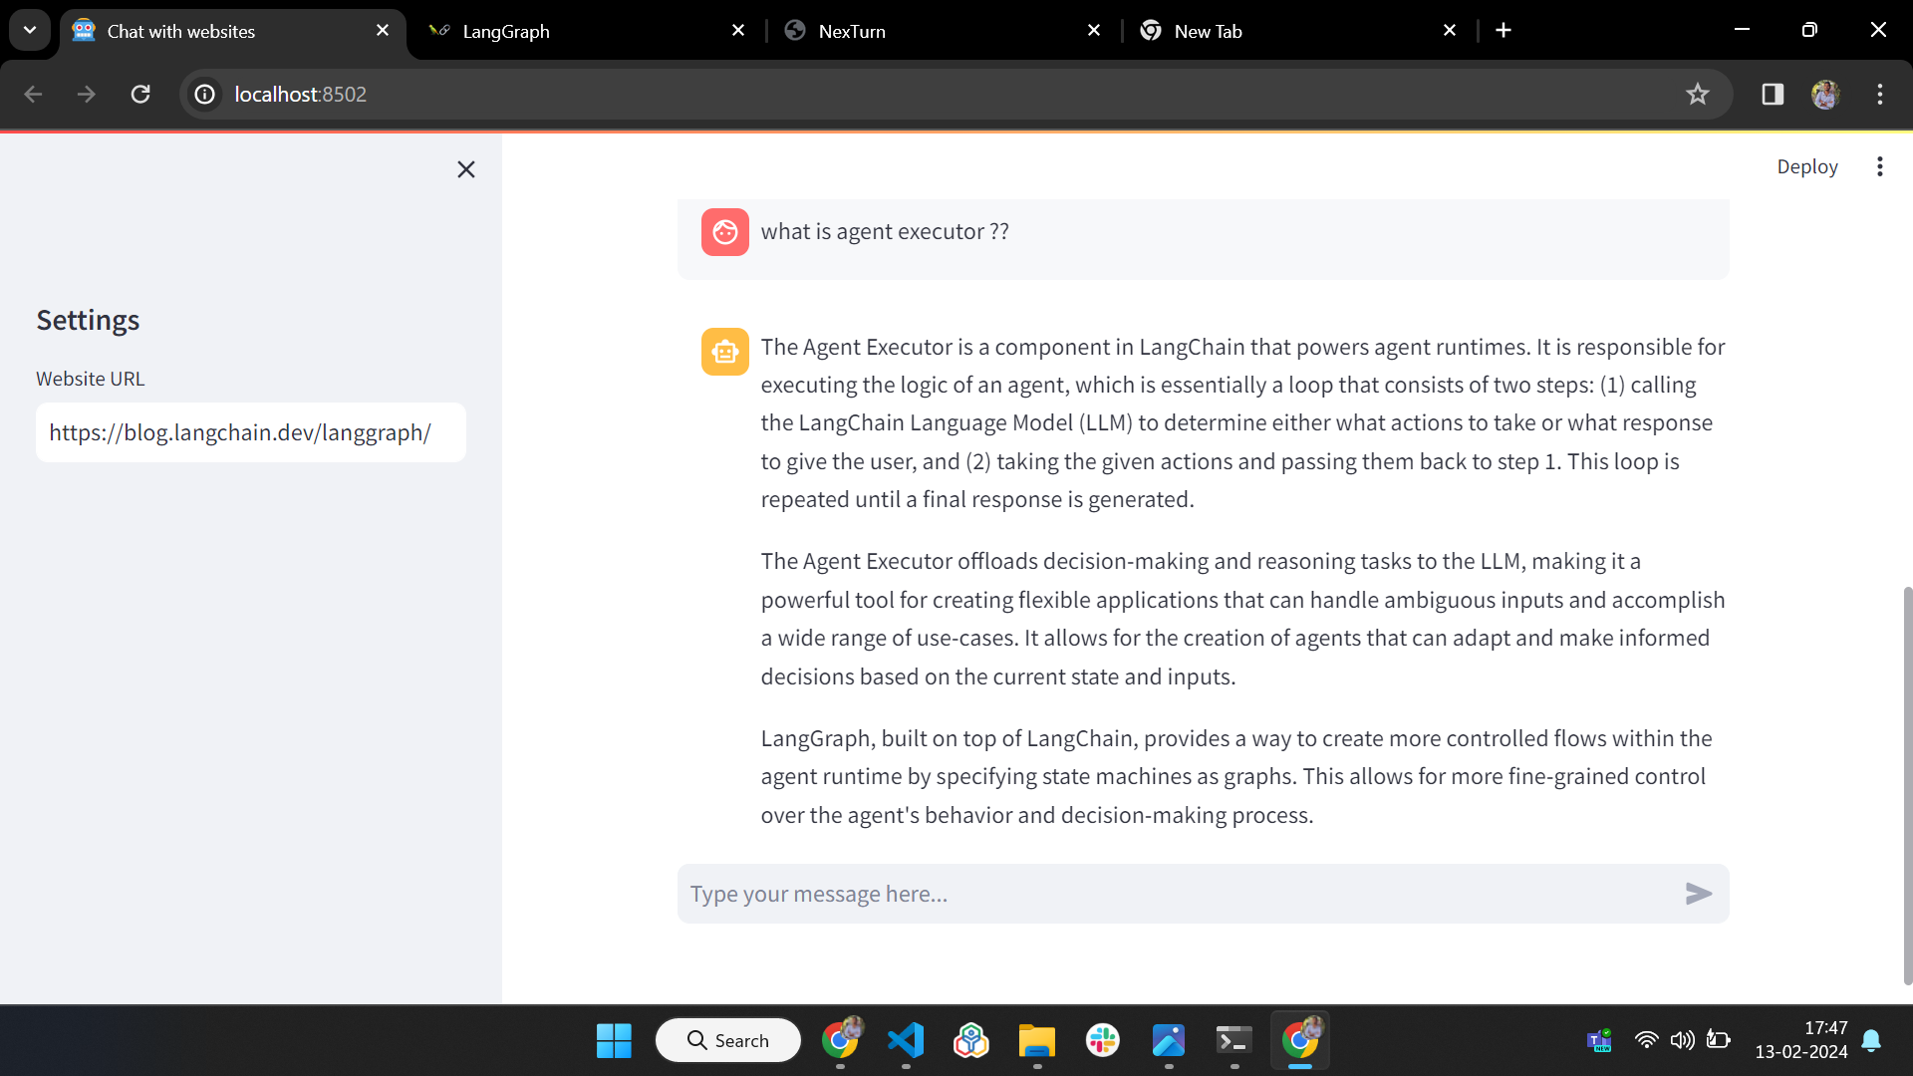
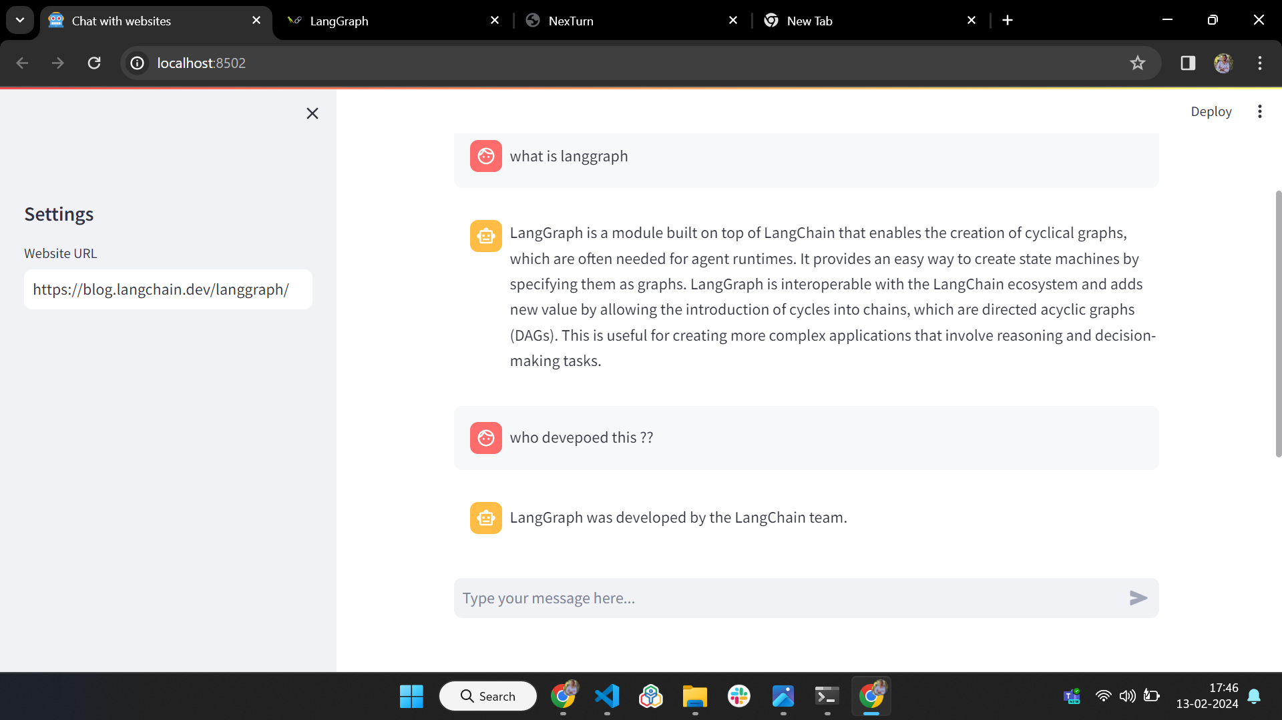
OUTPUT - using LLM (by training given Webite URL)

Slide 9
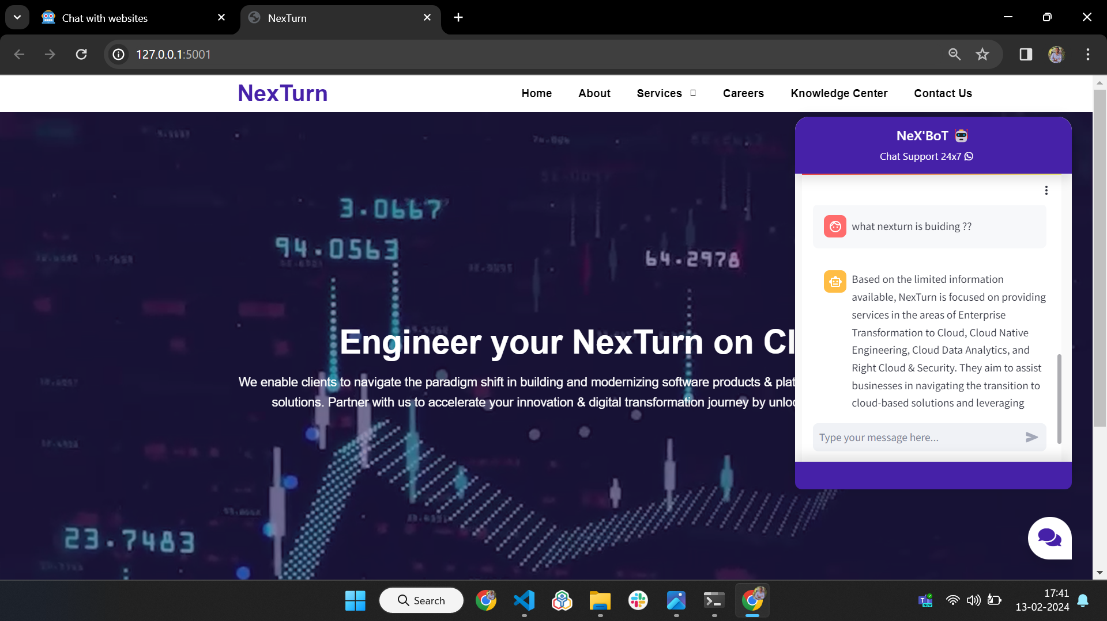
OUTPUT - using LLM (for our NexTurn)

Slide 10
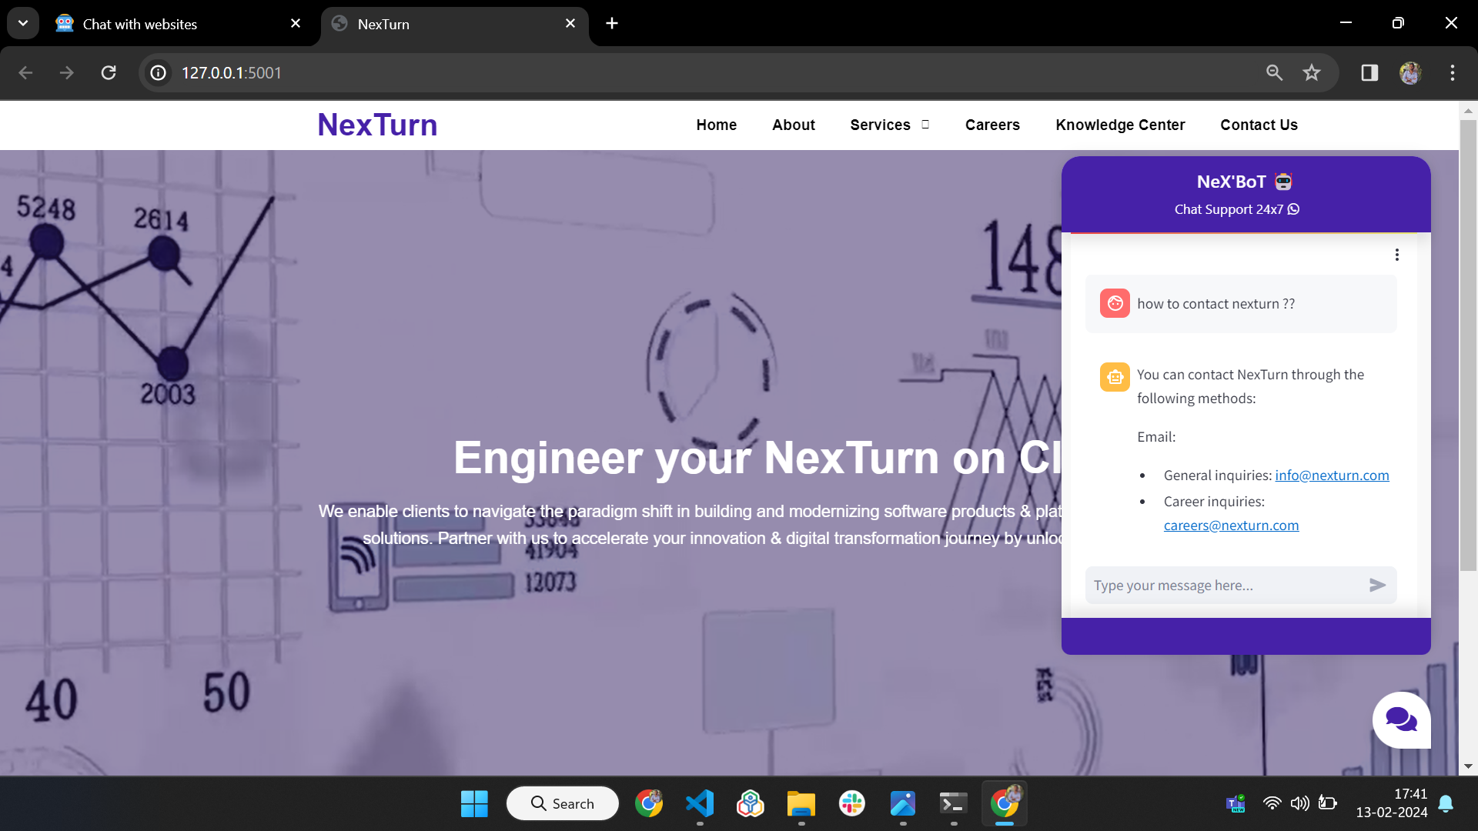
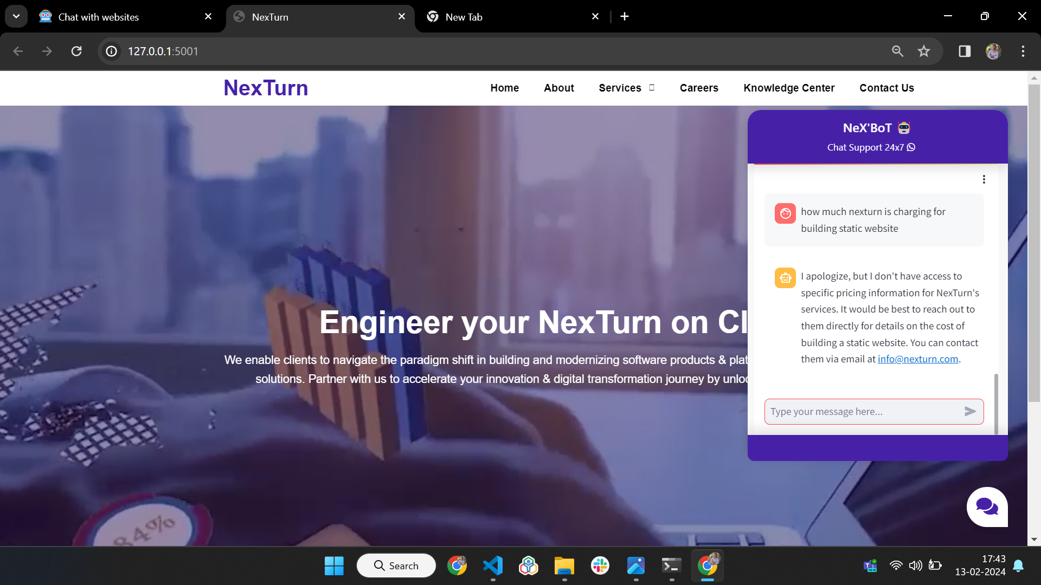
OUTPUT - using LLM

Slide 11

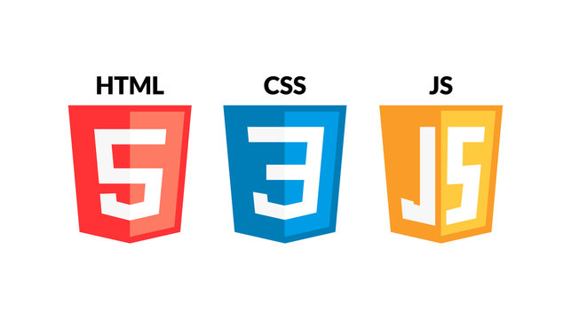
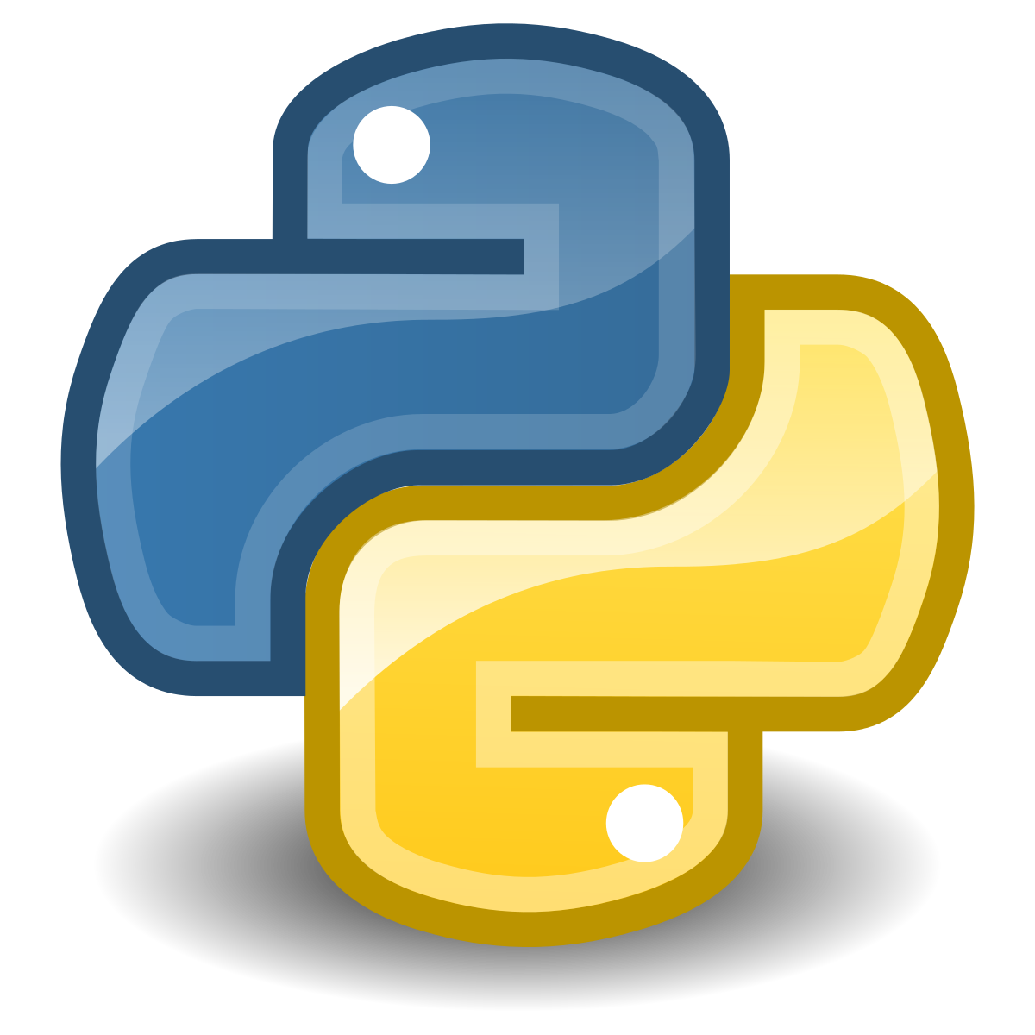
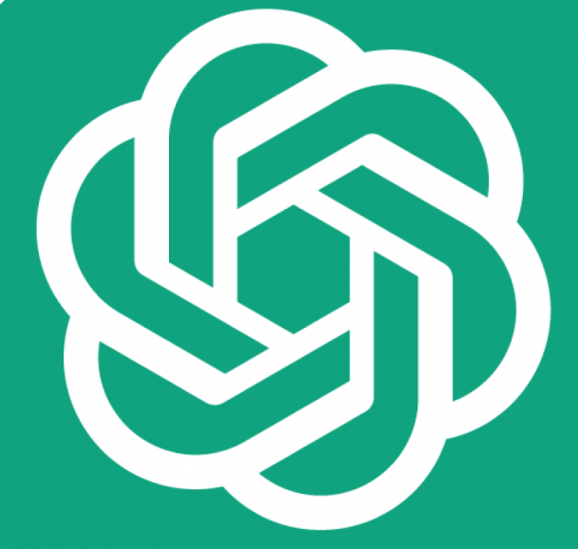
TECHNOLOGY STACK
HTML & CSS: To defines the structure and to styles the appearance of webpages.
JavaScript: To Add interactivity and dynamic behavior to web pages.
Streamlit: This Simplifies building interactive web apps using Python scripts.
Python: Simple, readable programming language used for diverse tasks.
OpenAI: Leading AI research organization advancing AI safely.
GPT-3.5 Turbo: Cutting-edge AI model for advanced NLP and generation.
+
+

Slide 12
CHALLENGES & NEXT STEPS
The challenges we have faced mainly involve backend integration, where we have not obtained the desired output, and understanding Streamlit has also been a hurdle.
As a future enhancement, we plan to incorporate multimedia and voice support in LLM as well. This would make it even more interactive for users.

